Slide 1
Questions

Slide 2
BYOD Controls: Can you lock down BYOD devices?
Decommissioning: Can you prove data was destroyed?
Zero Trust Complete: Can a new device access firm data without enrollment?
Incident Response: You have an incident, who you gonna call?
Breach Support: Who can evidence your cyber compliance?
Cyber Insurance Claim: What did you attest to in your application form?
Legacy IT Replacement: Are you paying too much for IT?

Slide 4
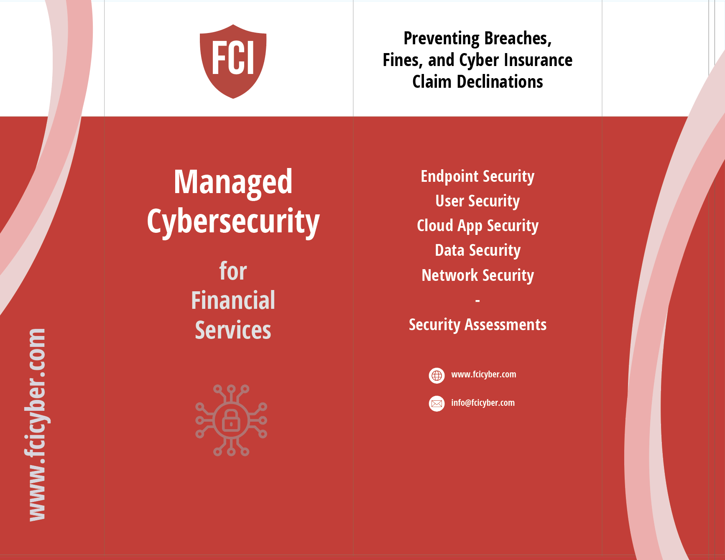

Slide 5
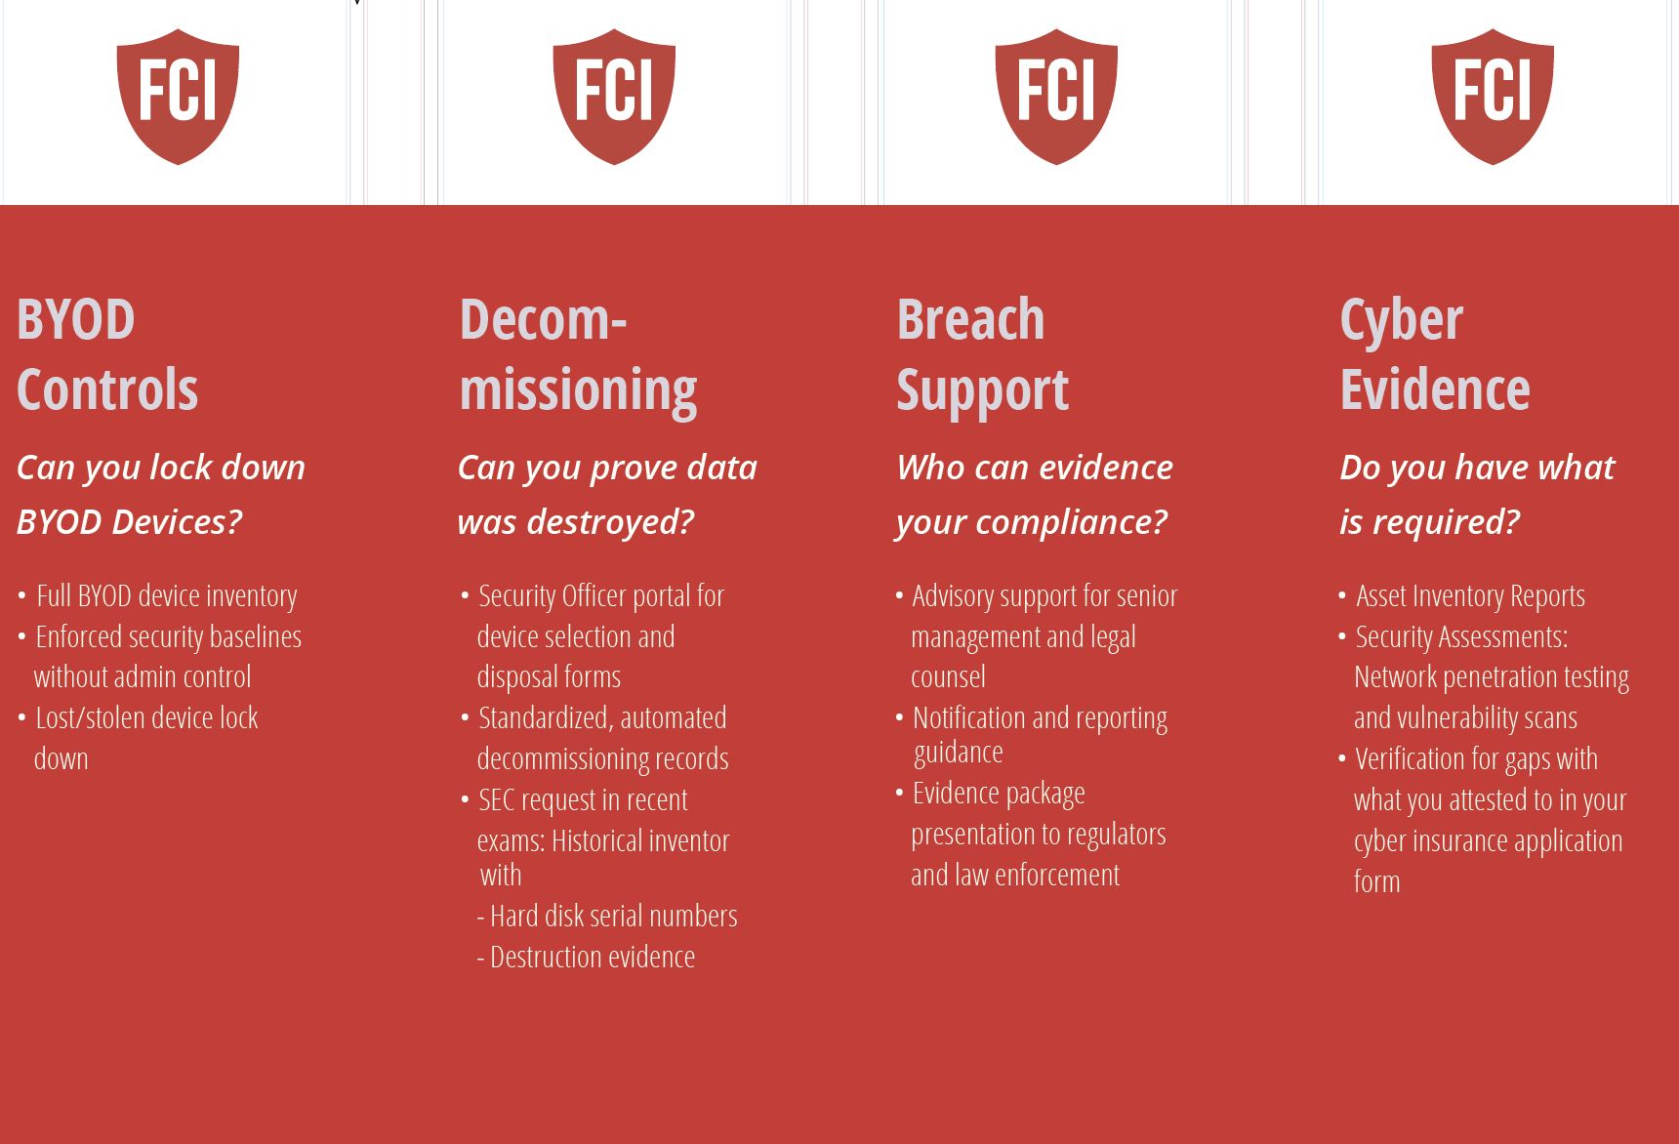

Slide 6
BYOD Controls
Can you lock down BYOD devices?
Full BYOD device inventory
Enforced security baselines without admin control
Lost/stolen device lock down

Slide 7
Decommissioning
Can you prove data was destroyed?
Security Officer portal for device selection and disposal forms
Standardized, automated decommissioning records
SEC request in recent exams: Historical inventory with
Hard disk serial numbers
Destruction evidence

Slide 8
Zero Trust Complete
Can a new device access firm data without enrollment?
User, device, and network verified before system access
Automated enforcement and remediation at scale
Cloud app and data protection with CASB controls

Slide 9
Incident Response
You have an incident, who you gonna call?
Forensics-led evidence collection and documentation
Evidence deletion or loss avoided by using trained experts
Immediate high-risk remediation and rapid containment
Breach determination

Slide 10
Breach Support
Who can evidence your cyber compliance?
Advisory support for senior management and legal counsel
Notification and reporting guidance
Evidence package presentation to regulators and law enforcement

Slide 11
Cyber Insurance Claim
What did you attest to in your application form?
Requirements increasingly aligned with regulators
Insurer cyber experts validate your evidence against your application
Claim denials driven by gaps between attestation and reality
Non-renewals and premium increases

Slide 12
Legacy IT Replacement
Are you paying too much for IT?
Migration from legacy stack to a secure, modern stack
IT-led Cyber or Cyber-led IT?
Shift from never-ending implementation to fast safeguard deployment
Automation to replace manual work and produce audit-ready evidence
Vendor due-diligence ready

